Slide 1
SCG-SH-0200
Southern Company Generation
Clearance Procedure
Awareness Training for
Contractors and Nonlisted Personnel

Slide 2
Southern Company Generation Clearance Procedure
--
Awareness Training for Workers Not Authorized to Hold a
Plant Clearance
Importance of SCG-SH-0200, Generation Clearance Procedure
Provides a system of accountability for non-plant personnel.
Maintains communications between working parties.

Slide 3
What is the Clearance Procedure?
  A lock-out/tag-out program in compliance with OSHA 1910.147, Lock-Out/Tag-Out, and OSHA 1910.269, the OSHA standard governing electric utility work.
  Most Southern Company Generation facilities use a tagging system for hazardous energy isolation rather than the lock-out /tag-out system you may be familiar with. The term “clearance” is used replacing the term “lock-out/tag-out” that you may be used to.
  Strict adherence to the clearance/lock-out/tag-out procedure is a condition of employment for everyone working on plant equipment at Southern Company facilities. Violation of the clearance procedure will lead to being barred from all Southern Company facilities.

Slide 4
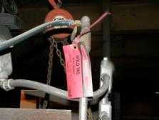
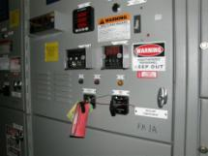
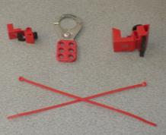
Important Terms
clearance – The process of safely shutting down, isolating, and tagging hazardous energy sources that must be contained to ensure that machines or equipment are secure and safe for maintenance, inspection, or servicing.
Referred to in most industries as “lock-out/tag-out.”
hazardous energy – Electrical, mechanical, hydraulic, pneumatic, chemical, radiation, thermal, or other energy sources that could cause injury.
approved energy isolation devices – Those devices (tags, cable ties, breaker clamps, and so forth) specifically provided by the facility for the identification and/or control of hazardous energy sources.

Slide 5
Important Terms (con.)
roster – A form used to document and track clearance holders.
Southern Company Clearance Roster – A document used to track all clearance holders authorized to accept a plant clearance.
supplemental roster – A roster, provided as part of the Southern Company Generation Clearance Program, that contractors may use as a means to document and track their employees working under a clearance.
Subclearance holder – A qualified Southern Company Generation employee who holds a clearance for a person or group of people who are not on the facility’s authorized list.

Slide 6
Important Terms
authorized list – A document maintained by the facility that identifies qualified employees and designated employees by name, and the type of clearance activities that each employee is permitted to perform.
nonlisted personnel – Any individual whose name is not included on the facility’s authorized list.
Examples of nonlisted personnel:
Southern Company Services employees
Contract workers
Generation support and personnel
from other plants
Visitors and vendors

Slide 7
Important Terms
designated operating area – An area or department of the plant that has the exclusive control of issuing and executing plant clearances in their specific area.
Examples are:
Boiler turbine operations • Fossil fuels
Laboratory • Individual hydro plants
Combustion turbine plants • Combined cycle plants

Slide 8
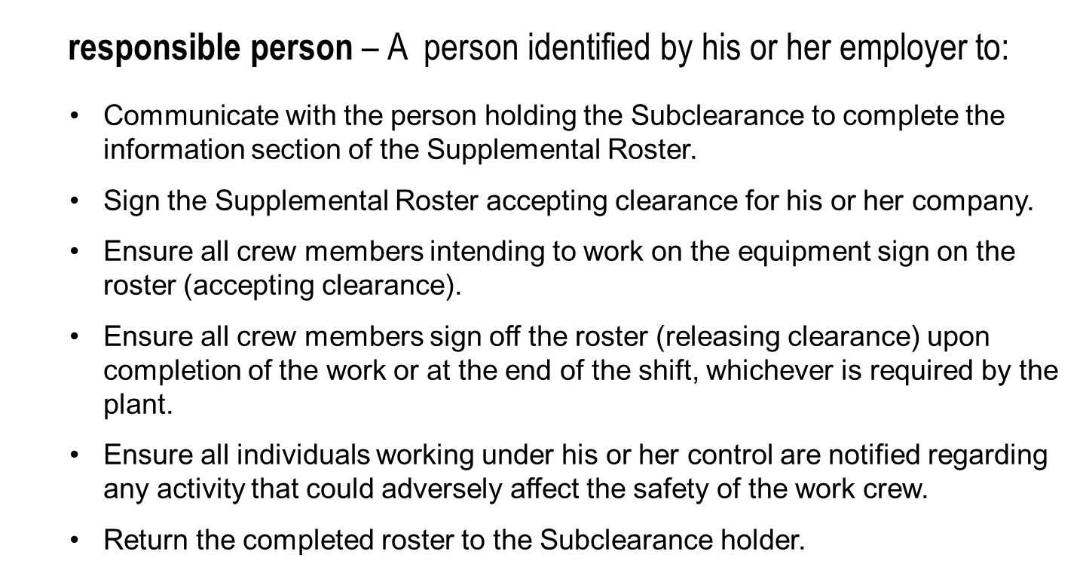
Important Terms

Slide 9
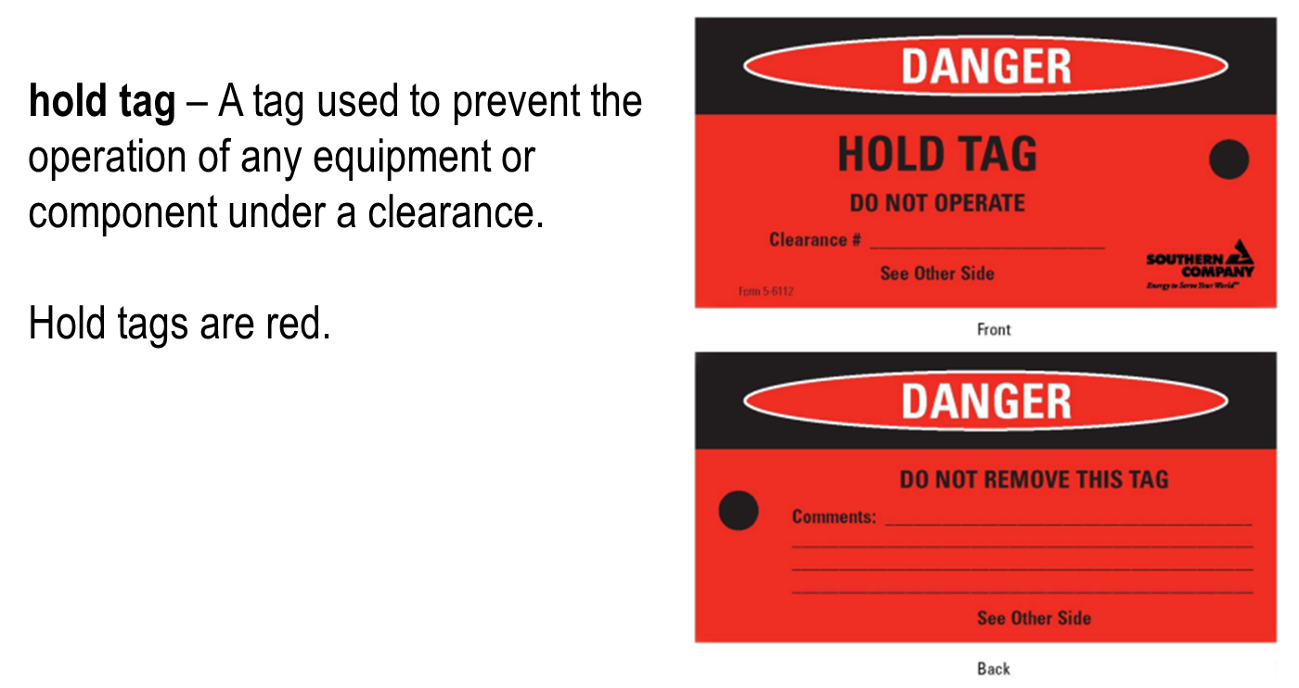
Important Terms

Slide 10
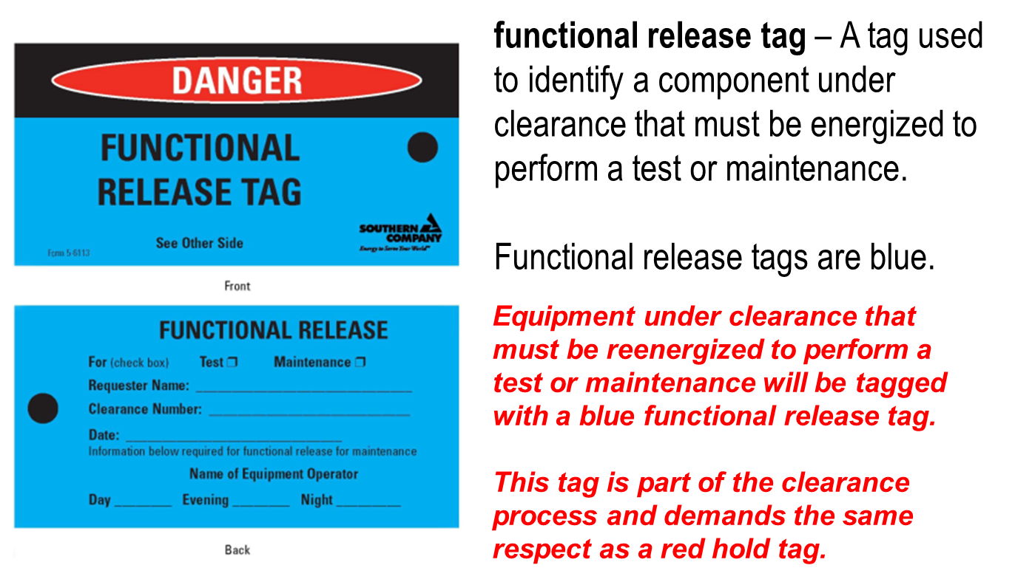
Important Terms

Slide 11
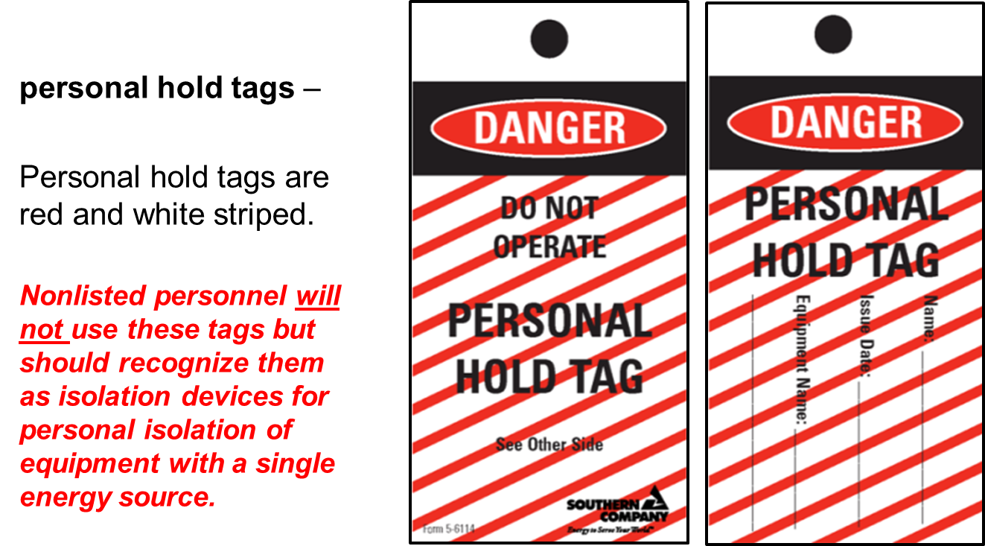
Important Terms

Slide 12
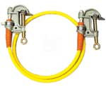
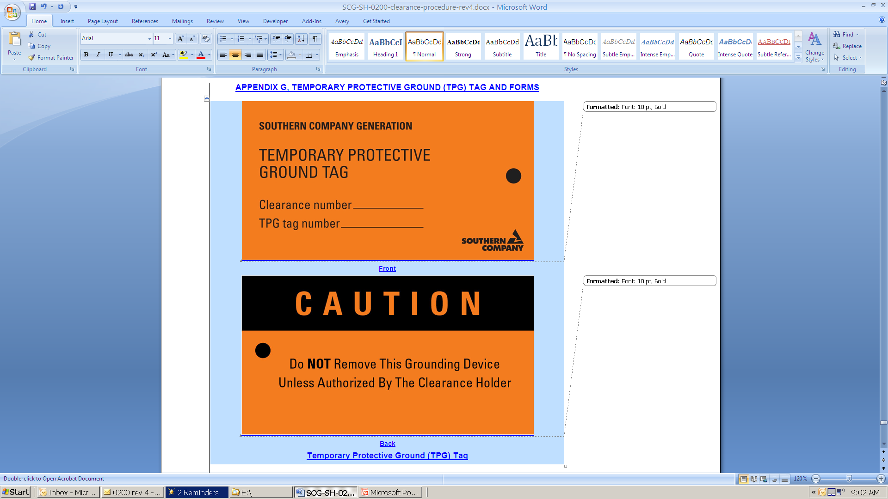
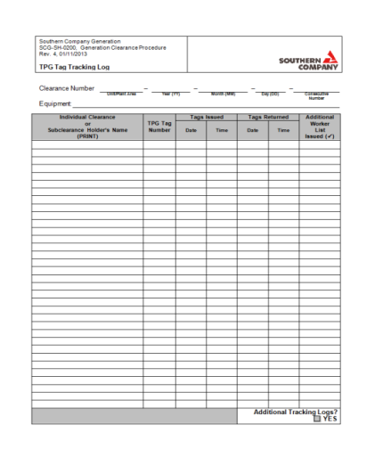
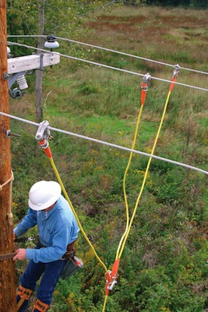

Important Terms
temporary protective grounds (TPGs) – Devices installed by qualified personnel for the purpose of grounding electrical equipment previously energized at a voltage greater than 600 V.
All TPGs installed on equipment under a plant (electrical) clearance shall be tagged with an orange TPG tag. The designated employee in the designated operating area shall record the orange tags issued and returned on the TPG Tag Tracking Log.
Should TPGs be needed for the work to be performed by non-listed personnel, a request for them should be may by the Responsible person to the holder of the subclearance.

Slide 13
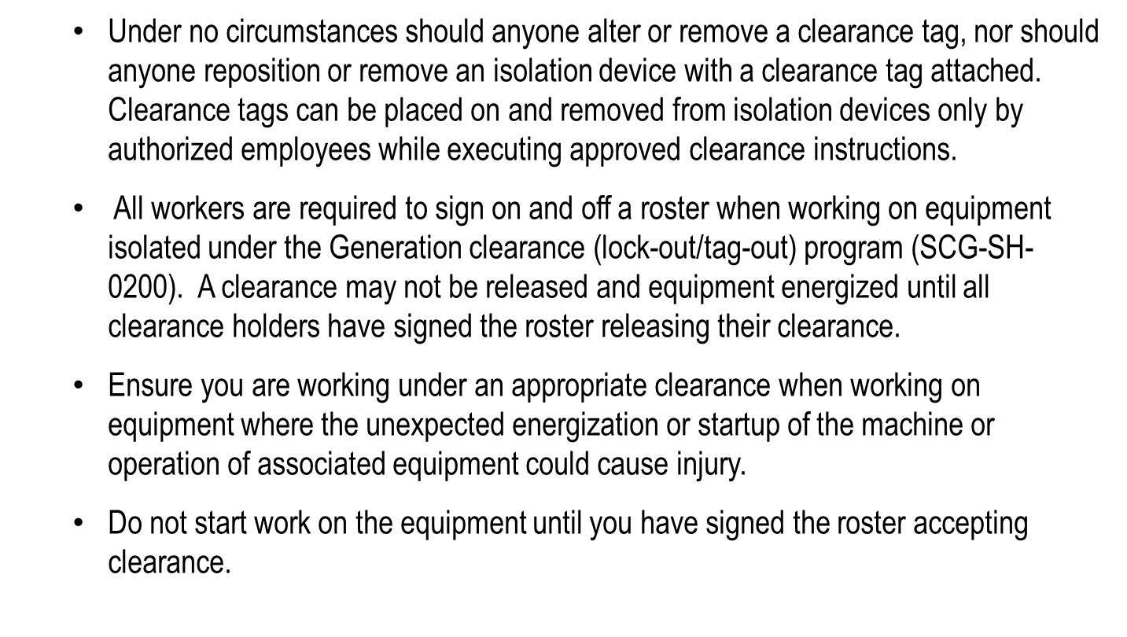
Generation Clearance Program Fundamentals

Slide 14
Generation Clearance Program Fundamentals (con.)
The Subclearance holder and the responsible person must have a clear understanding of the work scope. The Subclearance will ensure the person responsible for the work crew is afforded the opportunity to review the associated clearance instructions. A copy of the clearance instructions will be attached to the supplemental roster.
Most plant equipment has multiple energy sources. Clearances are written to isolate all energy sources necessary for the identified work scope. Make sure you are working on the correct equipment and are staying within the work scope as directed.
Remember you are protected only for the equipment and scope indicated on the clearance.
          Communication is critical!
  If you have ANY questions, STOP WORK and ASK.

Slide 15
Clearance Verification Example
Work scope :
  Replace bent lance tube on Unit 2 IK #3 10th floor south side
    This work is a complete teardown of the soot blower requiring isolation of multiple energy sources.
  Energy sources:
    Steam.
    Pressurized air.
    Electrical.

Slide 16
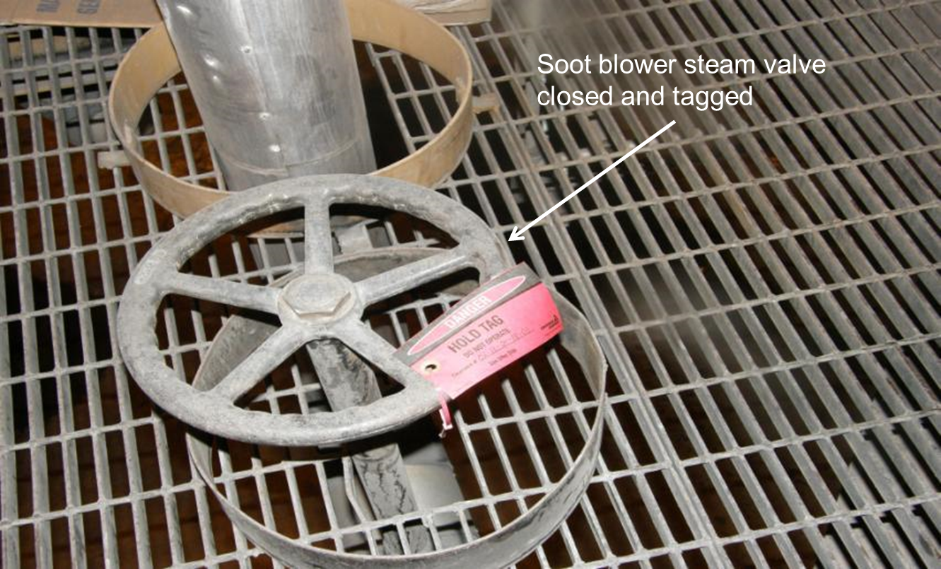
Steam

Slide 17
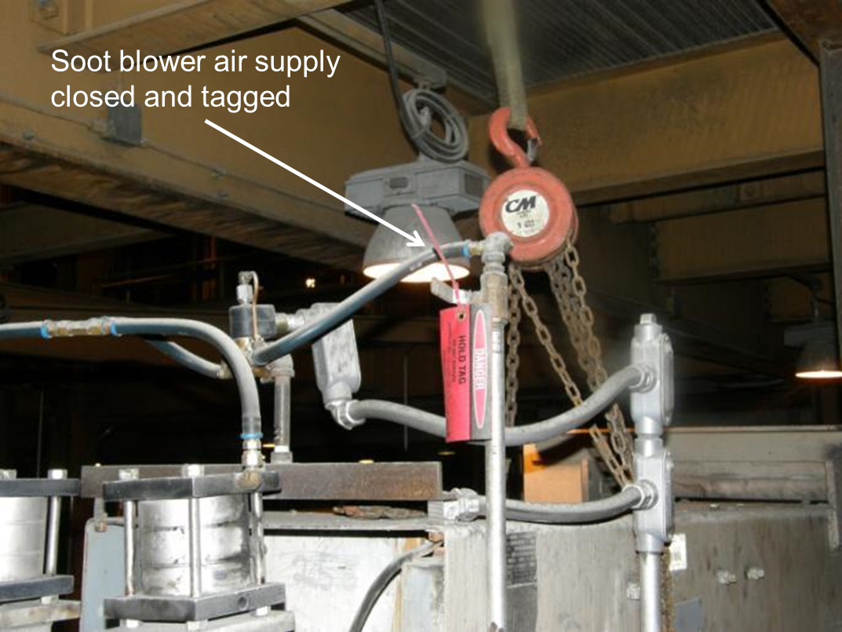
Air

Slide 18
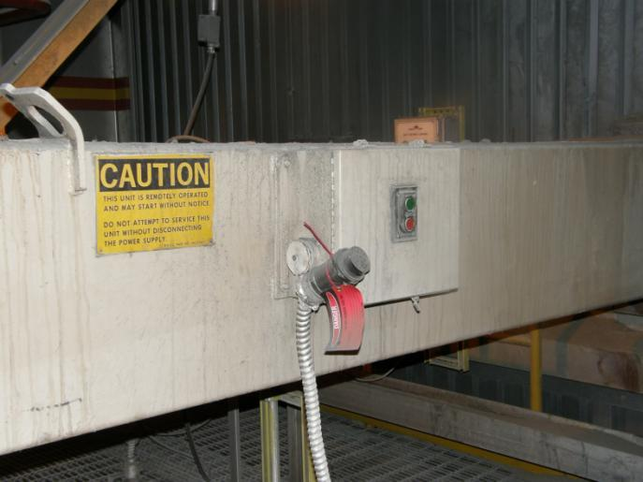
Electrical
Soot blower electrical supply disconnected and tagged

Slide 19
Steps In The Process
The Southern Company Generation representative requests a clearance on the equipment from the designated operating area.
The Southern Company Generation representative signs on the clearance as a Subclearance holder.
Before any work is performed, the Southern Company Generation representative verifies the clearance is adequate for the work scope and is properly executed (correct breaker racked out and tagged, valves properly positioned and tagged, and so forth).
The responsible person signs the Supplemental Roster accepting clearance for your company.
The authorized Southern Company employee who holds a Subclearance will ensure the person responsible for the work crew is afforded the opportunity to review the associated clearance instruction sheet(s). A copy of the clearance instructions shall be attached to the supplemental roster when issued.

Slide 20
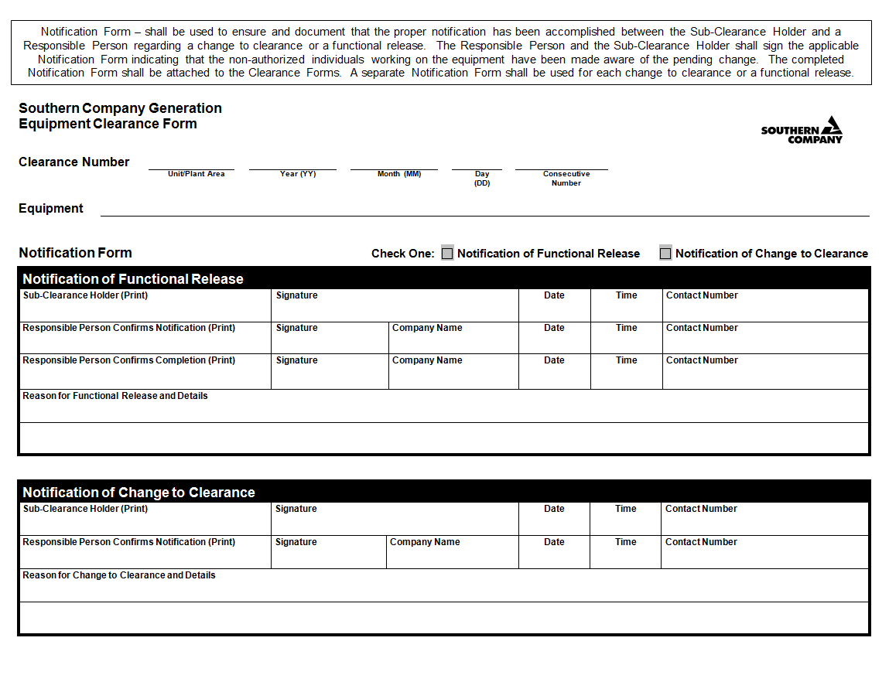
Steps In The Process (con.)
All individuals intending to work on the equipment must sign on the Supplemental Roster accepting clearance. The responsible person must also sign on the Supplemental Roster if he or she will be working on the equipment.
Perform work.
Note: If a change to clearance or a functional release must be performed, the Responsible Person must provide documented notification to the Subclearance holder that all individuals on the supplemental roster have been notified.

Slide 21
Steps In The Process (con.)
Clear all tools, cords, and material from equipment when the work has been completed.
At the completion of the work, all individuals must sign off the Supplemental Roster releasing clearance. After you sign your name releasing clearance, you must assume the equipment may start, may become energized or pressurized, and so forth at any moment.
No work can be performed on equipment after you have signed the Supplemental Roster releasing clearance.

Slide 22
Steps In The Process (con.)
The responsible person notifies the Subclearance holder and communicates the equipment status (ready for service, only our part is complete, still disassembled, and so forth).
The responsible person returns the completed Supplemental Roster to the Subclearance holder as verification that everyone has signed off releasing clearance.
The Subclearance holder returns the completed Supplemental Roster to the designated operating area and signs off the equipment clearance.

Slide 23
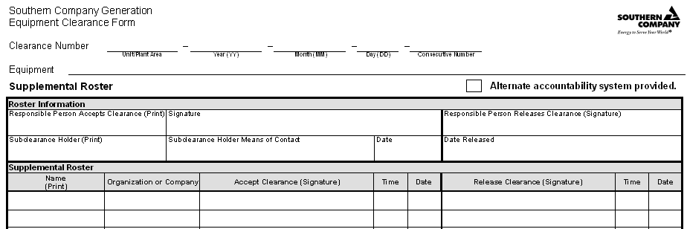
Completing the Form
The information required to be completed on the Supplemental Roster sheet includes:
The Subclearance holder and the person responsible for the work crew shall work together to complete the information section of the roster.
The person responsible for the work crew shall then ensure all individuals intending to work on the equipment under clearance sign on and off the roster.
01 07 10 14 001
1B condensate pump
John King John King
George Nix Plant phone ext 6523 10/14/07

Slide 24
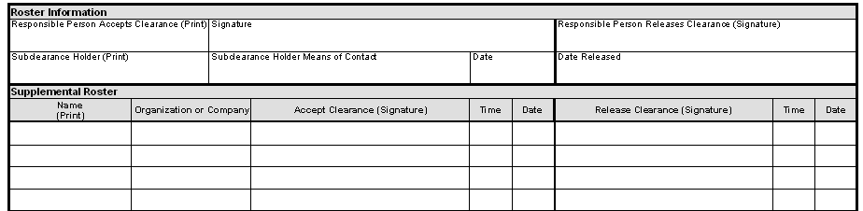
Completing the Form (con.)
The required information for the Roster includes:
Signing on the roster (accepting clearance): Each individual must legibly print and sign his or her name, name of the company or organization for which he or she works, along with the time and date he or she accepts clearance.
Signing off the roster (releasing clearance): Each individual must sign the corresponding space next to his or her original signature, along with the time and date that he or she releases the clearance.
John King
John King John King
George Nix Plant phone ext 6523 10/14/07
10/14/07
John King 1415 10/14/07
Ed White 1350 10/14/07
Joe Moss 1251 10/14/07
AB Word 1402 10/14/07
John King AMF John King 0945 10/14/07
Ed White AMF Ed White 0950 10/14/07
Joe Moss AMF Joe Moss 0951 10/14/07
AB Word AMF AB Word 0952 10/14/07
Each individual employee who works on the equipment shall sign off the Roster, releasing clearance, upon the completion of his or her work or at the end of his or her shift, whichever is required by the facility.

Slide 25

Final Note
If you are unsure how to proceed or if concerns arise, STOP. Contact your employer representative!

Slide 26

QUESTIONS?

